Slide 1


MELTDOWN
Adam Marciszewski, Brandon Franklin

Slide 2

WHAT IS MELTDOWN?
Meltdown is an out-of-order execution side-channel vulnerability
Uses out-of-order execution to leak information from anywhere in memory including the operating system kernel
Difficult to prevent because the vulnerability takes advantage of the CPU’s hardware design and is not due to any software’s issues

Slide 3
WHO IS AT RISK?
Meltdown primarily affects devices that use Intel CPUs

Slide 4
MELTDOWN PROCESS
1. Induce out-of-order execution
2. Simultaneously expand delay between data reads and permission checks
3. Recover data from pre-cleared cache using load timing to deduce a cache hit or miss

Slide 5
METHODOLOGY
Attack Consists of four stages (repeated 1000 times):
Flush the cache
Occupy the ALU
Load the kernel data
Reload data via side channel

Slide 6
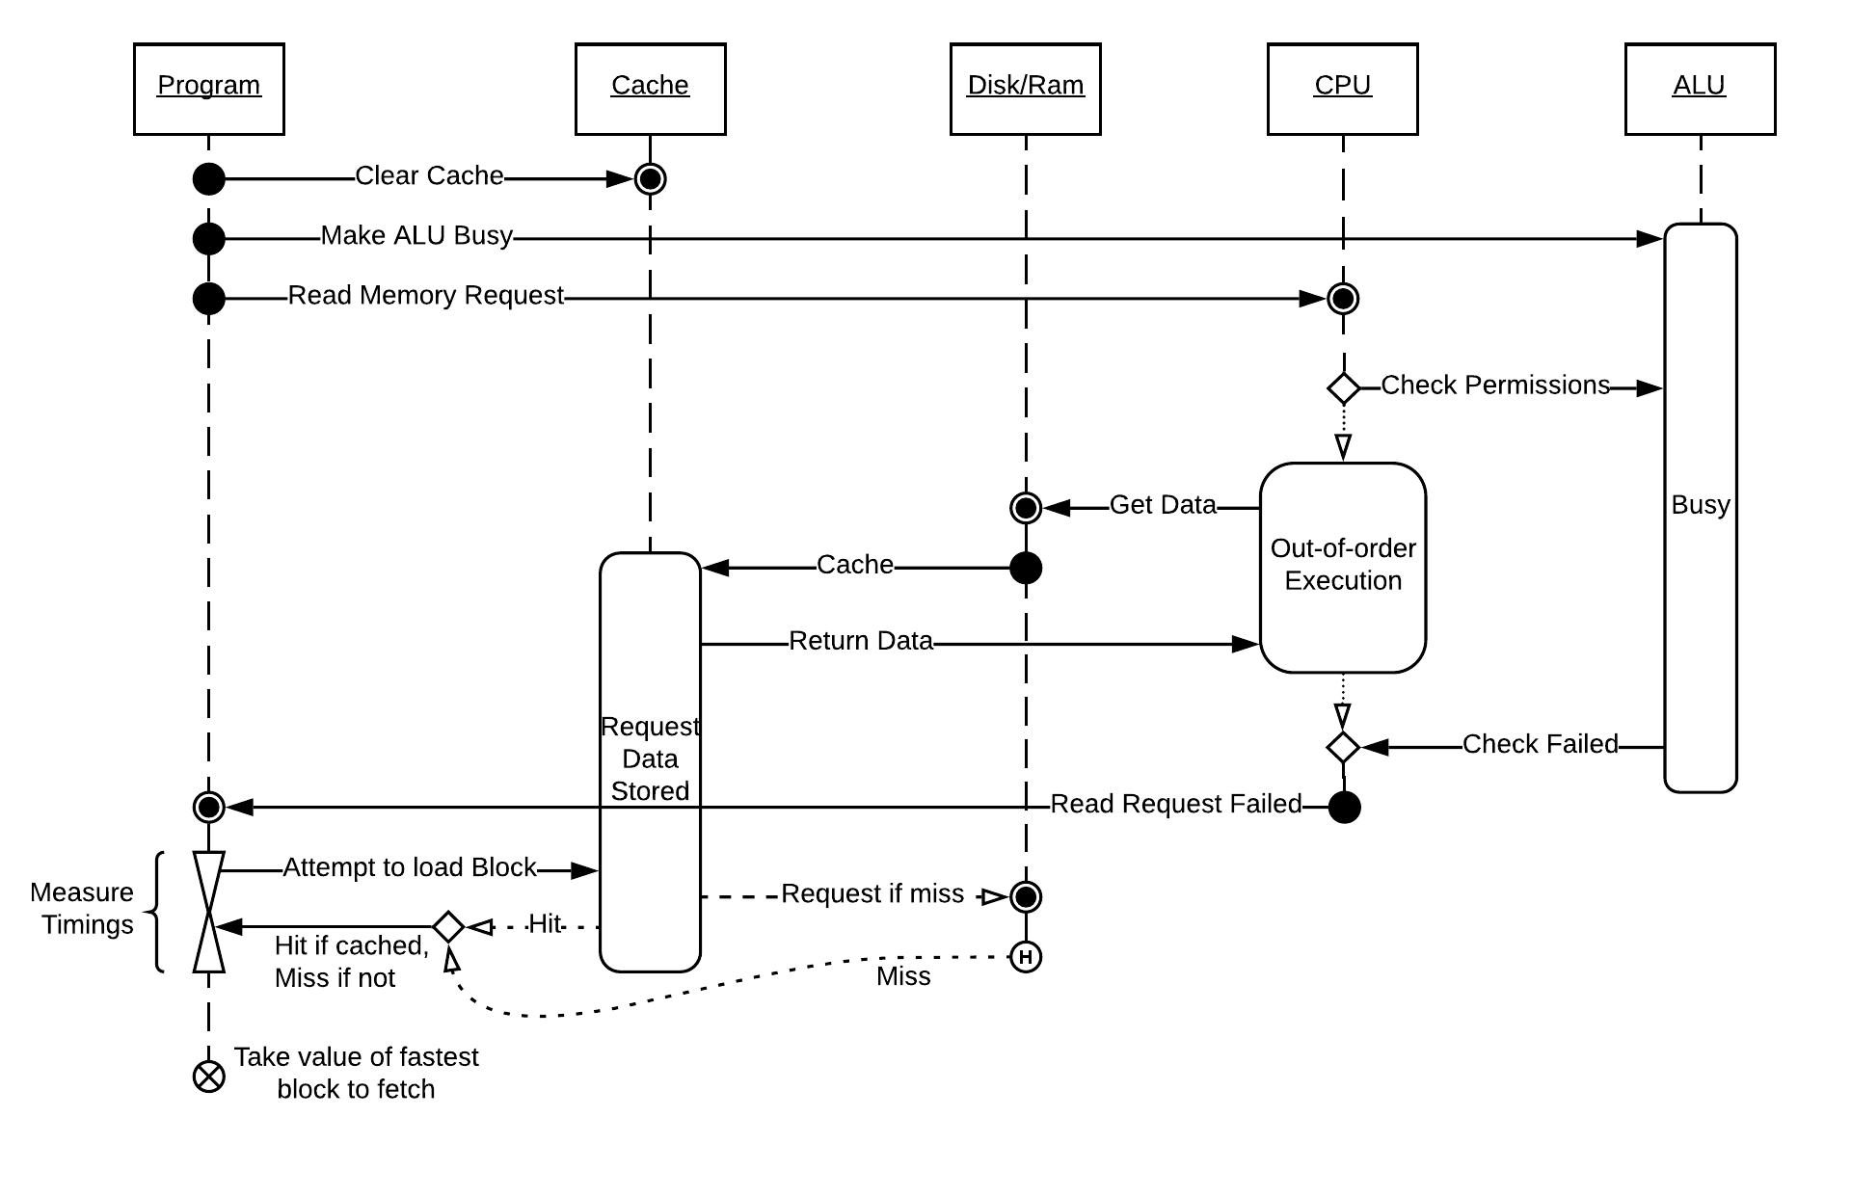

Slide 7
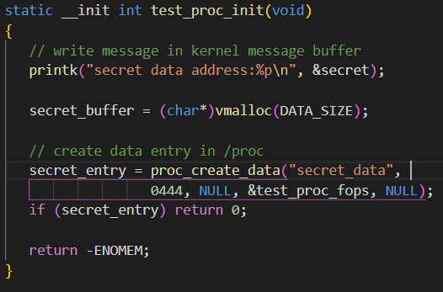
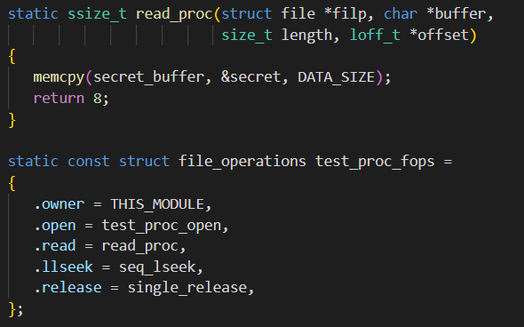

Slide 8
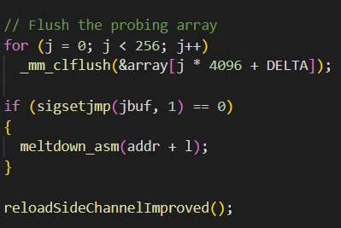

Slide 9
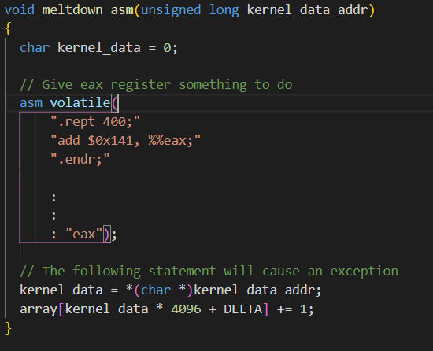

Slide 10
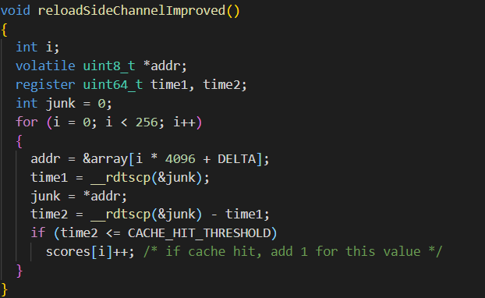

Slide 11
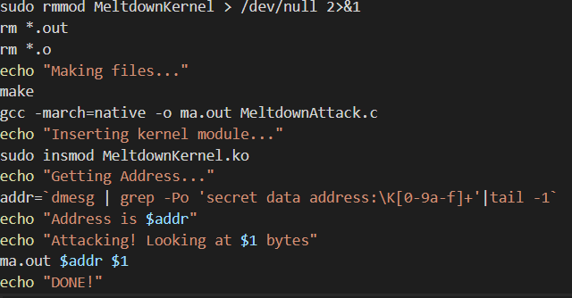

Slide 12
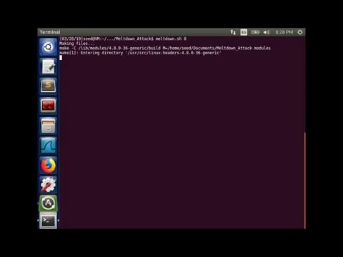

Slide 13
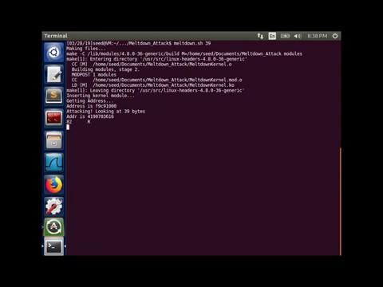

Slide 14
Countermeasures
There are patches against Meltdown on Windows, Linux and OS X
The patches only make the attack more difficult to conduct
Patches do not eliminate the risk

Slide 15

THANK YOU

